Slide 1
Unit 1. Introduction to Software Development and Application Security
Dr. Keshav Sinha

Slide 2
Unit objectives
After completing this unit, you should be able to:
Get an overview of traditional and modern programming languages
Understand the software development life cycle and its components
Gain insight on the need of application security
Identify the secure application development principles
Comprehend secure software development methodology

Slide 3
Introduction to Software Development
The compound word software development has two parts, software plus development.
Here the first part, software is a well-defined collection of computer programs.
A computer program is a well-defined collection of computer codes written in a programming language.
A computer program is built using the concept of stacking and nesting of computer codes and the execution of the codes is governed by the programming logic of sequence, selection, and repetition.
The role of a computer program is basically to perform the desired task as coded by a computer programmer, who is otherwise known as a software developer.
A computer program thus enables a computer to take input, process it, and generate result(s) as output.
Computer software, thereby, governs computer hardware and brings it to functionality.

Slide 4
Introduction to Software Development
Without software, a computer cannot perform data processing, number crunching, and web application tasks that need the usage of Internet, servers, and electricity.
The second part development is the process of creating, improving, and advancing a computer program in a logical manner observing to the latest and improved algorithms and data structures that consolidate a computer program.
An optimized computer program minimizes time and space complexity, which needs innovation, research, and endeavor from the software developer’s end.
The art of computer programming is a wonderful, imaginative, and revered job that is ever appreciated by humankind.

Slide 5
Introduction to Software Development
Once a logical set up of the optimized computer programs are made and is consolidated as software, it can be used for application or operating system purpose as it is intended.
The task of a software developer is to develop software for computer system that can act as an operating system or can be tailor-made for a specific application such as web application, database application, or custom application.
Software development is a process of creating a new software or improving the existing software that caters to the current needs of computing devices, organizations, groups, or individuals by planning, designing, implementing, testing, and maintaining the developed software.

Slide 6
Essence of Software Development
Paradigm shift from paper-based to computer-based work environments in the contemporary world.
Information technology gained impetus to provide and obtain information quickly.
The world is universally reliant on computing power, interconnected computers, and networks (intranet, extranet, Internet).
Essential for organizations to empower users with omnipresence, omniscience, and omnipotence through information rendering.
Enables easy access to information in the digital world.
Transition from traditional library-based searches to electronic-based searches using search engines like Google.

Slide 7
Essence of Software Development
Search engines (e.g., Bing, Yahoo, Google) are software that performs thorough searches across global databases based on user-entered keywords.
Organizations aim to be visible on the first page of search results to attract more clients and business.
Create a web application to promote the company, its essence, and services.
Market the web application for search engine optimization, ensuring a high ranking in search results.
Ensure the security of the web application.
Emphasizes the need to make web applications secure for information protection and overall business integrity.

Slide 8
Learn about Software Development
Fundamentals of Software Development
Requires a deep understanding of programming languages.
Involves a systematic approach in the development process.
Obligates the use of a software development life cycle (SDLC).
Expedites development by following a standard and suitable software development methodology.
Choice of Programming Language
Depends on the usage and requirements of users, businesses, or computational machines.
Options range from machine language and assembly language to high-level language, very high-level language, and natural language.

Slide 9
Learn about Software Development
Modern developers should follow the latest technology, contemporary software development methodologies, and future-ready programming languages.
Enables the development of state-of-the-art application software and robust application security.
Implementation of robust application security protects information from misuse, breaches, and tampering, ensuring safety, security, and stability.
After deciding on the language and approach, creating a proposal document for the organization is essential.

Slide 10
Learn about Software Development
Begin with a feasibility analysis, ensuring financial soundness and technical feasibility of the proposed software development project.
Proceed to requirement analysis and specification to understand client requirements and organize them in a working document.
Utilize interviews, questionnaires, observations, and data flow diagrams to gather requirements.
Although there's no mathematical or logical approach to requirements gathering, following expert footsteps through various methods helps in analyzing business requirements.
Analyze if the project timeline aligns with programming hours needed for completion.
Strengthen human capital involved in programming for project success.

Slide 11
Software Development Process
It is a process of planning and managing software development.
It typically involves dividing software development work into smaller, parallel, or sequential steps or sub-processes.
It helps in to improve design and/or product management.
It is also known as a software development life cycle (SDLC).

Slide 12
STAGES OF SDLC PROCESS
Requirement Gathering
Design
Development/Build
Testing
Deploy And Maintain

Slide 13
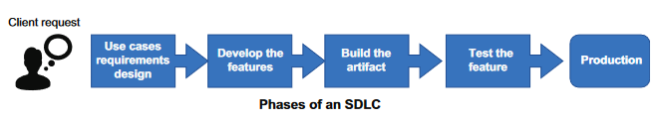
Application Security
Application security is the implementation of security through practices, tools, technology, people, and processes in the development life cycle
Challenges
Static Application Security Testing (SAST)
Dynamic Application Security Testing (DAST)
Software Composition Analysis (SCA)
Web application firewalls (WAF)
Run-time application security protection (RASP)

Slide 14
Fundamentals of Application Security
Involves controls or countermeasures within system and application software.
Encompasses operating systems and specific software developed for various purposes (e.g., web applications, database applications).
Database applications require specific security controls to manage risks associated with the volume of handled data.
Web applications need specialized controls due to accessibility requirements, mitigating the risk of information system infiltration.

Slide 15
Fundamentals of Application Security
Emphasizes the need to develop software securely and in a controlled manner throughout the software development life cycle.
Identifies security risks in software development, including malware, bugs, unseen vulnerabilities, and careless programming practices.
Highlights that these security risks serve as major means for attackers to achieve unauthorized access, system intrusions, breaches, and network misuse.
Underscores that improper processing can affect integrity, leading to data accuracy issues, and development errors may create availability problems, facilitating inappropriate data access.
Stresses the necessity of application security testing during security system testing, covering controls, resistance to buffer overflow, use of cryptography, internet user sessions, and cookie usage for confidentiality and integrity protection.
Advocates addressing application security vulnerabilities systematically by adhering to secure architecture and design guidelines.

Slide 16
Fundamentals of Application Security
Key Vulnerability Focus Areas:
Outlines key vulnerability focus areas for secure software development, including input validation (IV), sensitive data (SD), authentication, configuration management (CM), authorization, session management (SM), parameter manipulation (PM), cryptography, auditing and logging, and exception management (EM).
These areas are prone to errors and require careful attention.

Slide 17
Essentials of Application Security
Applications play a crucial role in ensuring system security through the implementation of appropriate controls, edit checks, and audit trails.
Developing a robust application with security in mind poses challenges for software developers, graphic designers, and system architects.
Building hack-resilient applications requires meeting current security needs, as insecure design may lead to doubts about implementation and potential security breaches.
Offering access to basic business functionality through web-based applications introduces new security vulnerabilities, even with firewalls and monitoring systems in place.
Implementation of application security concepts is essential to prevent security breaches, and information security professionals should understand the development environment to guide security checks in projects.

Slide 18
Essentials of Application Security
Some software, such as malware, is intentionally developed to exploit security weaknesses, requiring specific study and countermeasures.
Beyond malware, security risks include bugs, unseen vulnerabilities, and careless programming practices, serving as means for unauthorized access, system intrusions, and breaches.
Improper processing can compromise integrity, and development errors may hinder availability, emphasizing the importance of a safe and controlled development approach.
Software can be either a security weakness or strength, depending on proper design and implementation, influencing data accuracy, access control, system functionality, and data tracking.

Slide 19
Learn the concept of Terms of Service (ToS) on Application Security
You need to apply sound design and architectural best practices, incorporate organization’s security policies and standards, and reflect on deployment strategies in order to build a robust application.
Database applications, while a mature and established technology, have specialized requirements and security risks inherent in the volume of data being manage.
Web applications also have specific risks, due to the accessibility requirements, which can have some of the major points of attack for penetration of information system as a whole, owing to the fact that web servers are often connected on both sides of a firewall.

Slide 20
Learn the concept of Terms of Service (ToS) on Application Security
Remember from computer and security architecture perspective, application versus operating system is a highly simplified view of the complexity of an actual computer operation, and also that complexity is the enemy of security.
Software protection controls may be applied to any or all of the components, and that software development controls should be applied to all.
The complexity of the many components that can be involved in a given application, management and controls on the development of the system are all the more important.
Systems and Software Development Projects rarely meet the expectations of the business and seldom integrate the required security principles into the final product.

Slide 21
Learn the concept of Terms of Service (ToS) on Application Security
Emphasizes the significance of organizations following good project management controls.
Recommends the use of a systems development methodology such as the Systems Development Life Cycle (SDLC).
Highlights the need for the active involvement of both the business and security departments throughout the project's lifespan.
Stresses the importance of implementing change management controls to prevent uncontrolled changes and mitigate the risks of scope creep.
Addresses the increased difficulty of ensuring security in modern business processes and systems due to their complexity.
Points out that many applications interface with multiple backend systems or data sources, often through Middleware.
Integration of data and systems complicates data protection efforts, especially in ensuring compliance with privacy regulations.

Slide 22
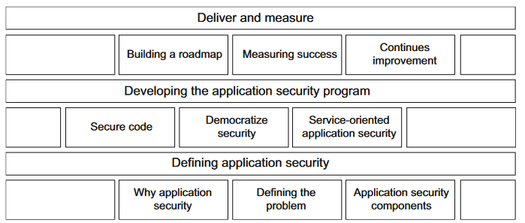
The three parts of application security

Slide 23
Defining application security looks at what an application security program is and its purpose in software development.
■ the reasons for creating an application security program
and why is it important today.
■ identifies the risks, threats, and activities that impact our ability to
create and deliver secure software.
■ covers the different components of application security and how they
are applied in an organization.

Slide 24
Developing the application security program focuses on creating the application security program within an organization and the steps that should be followed.
■ shows how modern software development creates an opportunity for us to integrate security in a way that provides faster feedback to the development teams.
■ the concept of a shared responsibility model that should exist between security and the engineering organization.
■ the concept of making application security functions and tools as a callable service that can be leveraged at all stages of the software development life cycle.

Slide 25
Deliver and measure covers how to measure the effectiveness of the program and identify areas of improvement.
■ guidance on building out a roadmap to address building
security into the software development life cycle
■ what to measure and how to measure the effectiveness of your application security program.
■ how to keep your program on track.

Slide 26
Top 25 Software Errors | SANS Institute
OWASP Top 10 API Security Risks – 2023 - OWASP API Security Top 10
CVE - CVE (mitre.org)
CWE - Common Weakness Enumeration (mitre.org)
Cybersecurity Framework | NIST

Slide 27
Program Utilities
Assembler: Translates assembly language to machine language. There is a close correspondence between assembly mnemonic codes and machine opcodes.
Compiler: “Translates a high-level language into machine language”.
Interpreter: “Instead of compiling a program at once, the interpreter translates it statement-by-statement”.

Slide 28
Basics of Programming Languages
Programming languages were developed over the years and improved in both ease of use and increased functionality
First generation: Machine language is the first-generation programming language that uses binary codes in the form of bits comprising of series of 0s & 1s, vacuum tubes as internal circuits for processing of codes, magnetic drums for storing coded data, and was prevalent in the year 1940 to 1956.
Second generation: Assembly language is the second-generation programming language that uses mnemonic codes comprising of small words representing commands such as ADD, MUL, etc., transistors for internal circuits for processing of codes, magnetic tapes for storing of coded data, and was prevalent in the year 1956 to 1963.
Third generation: High-level language is the third-generation programming language that uses human understandable traditional code for creating programs such as while, if, etc.; integrated circuits for processing of programs; magnetic disk for storing coded data; and was prevalent in the year 1964 to 1971. ( C, Pascal).
Fourth generation: Very high-level language is the fourth-generation programming language that uses declarative, object oriented, and English-like programming language commands independent of the traditional input, process, and output logic; micro-processors for processing of programs; and was prevalent in the year 1971 to present. (SQL, VB, Lisp).
Fifth generation: Natural language is the fifth-generation programming language that currently uses artificial intelligence technology and is presently used in various computing devices including mobile phones; some of the famous current AI implementation includes Cortana from Microsoft, Google Now from Google, and Siri from Apple.

Slide 29
Programming Concepts
System model: Instructions regarding source code files, development tools (such as compilers), and options to be used in creating the program or application.
Von Neumann architecture: Is now used so widely that it is sometimes thought to be the only architectural model. In the Von Neumann architecture, there is no difference between data and code. Code can be processed as data; data can be executed. Malware can modify existing programs. Malformed input can inject data into locations where it will be executed as programming.
Object-Oriented Programming (OOP): The OOP concept is used in C++, which is the composite of C with object oriented programming features. The basic merit of OOP is its code reusability that reduces development time and minimizes coding cost. Now, if you are developing a program in a language that has the OOP built into it then you can be rest assured that the code that you type in once can be used by you as well as other programmers and vice versa, making it runnable on multiple programs.

Slide 30
Distributed Programming
Distributed programming: Distributed programming requires abstract communication between hosts. Distributed computing entails programs located on different cooperating in the same application. Applications are divided into components; each can operate in a different location/platform.
The four major protocols in use today are:
Distributed Component Object Model (DCOM)
Service Oriented Architecture Protocol (SOAP)
Common Object Request Broker Architecture (CORBA)
Enterprise Java Beans (EJB)

Slide 31
Information Security Triad
Confidentiality: The application must ensure that access is only given to authorized people or The program (application) must also ensure that each user only gets access according to their privilege level. The application should limit the use of the application and data to the intended purposes and covert channels and object reuse.
Integrity: The application can often prevent the corruption of data through proper edit checks and The application must also be written to ensure the correct and complete processing of transactions. Malware may specifically target the integrity of the data.
Availability: The whole purpose of an application security is to make it easy for users to access data The application must be written in such a way as to provide the information promptly. Even when applications are used as intended if the application is not optimized for the number of users it may fail.

Slide 32
Web Application Security Principles
Input/Output Validation:
Validate all data to ensure only known valid inputs and outputs are accepted.
Fail-Secure (Closed):
Design to secure failures; if a component fails, ensure it fails in a secure state (e.g., firewall disallowing all traffic upon a crash).
Fail-Safe (Opened):
Prevent cascading failures; if a part fails, it shouldn't disrupt the entire system, emphasizing availability over confidentiality.
Simplicity in Design:
Keep security systems simple to encourage use and avoid user workarounds (e.g., complex password policies leading to insecure practices).
Defense in Depth:
Design a layered security approach; if one layer fails, others should catch breaches, providing defense in depth.

Slide 33
Web Application Security Principles
Weakest Link Principle:
Identify and strengthen the weakest link in security, as attackers exploit vulnerabilities in the system.
No Security by Obscurity:
Avoid relying on secrecy alone for protection; instead, focus on robust security measures.
No Caching of Secure Pages:
Configure clients not to store data transmitted via HTTPS for enhanced security.
Industry-Standard Encryption:
Utilize recognized encryption standards like AES for secure data protection.
Monitor Third-Party Code:
Regularly check security bulletins for applications and OS from third-party vendors to stay informed.
Validate Data:
Perform bounds checking on user and partner data to ensure it aligns with known values.

Slide 34
Application Design & Development Security
Secure design methodology: It includes list required skills by developers, attack surface analyst, threat modelling and security design review.
Secure development methodology: It should be used such as: assessment tools, check-in reviews, peer reviews, and version control of updates/configuration changes.
Security testing: It should have predetermined criteria and testing methodology. Tools for security testing include: Static Scanners, Coverage tools, Control coverage, Fuzzing and Penetration testing. Exceptions and error conditions should push the application past the data norms.

Slide 35
Application Design & Development Security
Change control and configuration management: For the application and the operating system, the application will reside or must be defined and moved from known-good to known-good.
Certification: It is the technical evaluation of the system and the risk it poses to the environment accreditation is management’s acceptance of the risk of operating system in the environment. C & A process must be clearly defined.
Vulnerability response plan: It is the vendor sided of patch management. When vulnerability is reported how is it handled? What validation is in place? What is the update preparation, update notification, and update dispersal process? How does the user community find out? Is your local CERT/FIRST team notified? Are your customers notified directly or via CVE?

Slide 36
Environment and Controls
Security of the environment: It is controlled via physical controls.
Physical and logical separation of duties: It can be achieved with separate software interfaces.
Separation of production and development environments: It is performed by creating and using development sandbox with permissions limited to the development team.
Retention of key personnel/knowledge: It is possible using good hiring practices.
Documentation of programs/systems/error handling: It is done by development team will aid next version development and vulnerability management.
Security and monitoring of off-hours access: It is another physical security control coupled with the access control systems; it will help in the event of an investigation.
Preventing social engineering: Through routine awareness training, ensure that everyone is trained on proper procedures. Following established security procedures. Following established security procedures is an excellent way to combat social engineering.

Slide 37
Additional Software Protection Mechanisms
Cryptography
Access controls
Validation of external components
Purchased APIs and libraries
Backup and redundancy controls
Training
Transaction controls
Malicious code control
Documentation and common program controls
Testing and evaluation

Slide 38
Auditing and Assurance Mechanism
Describe policies and techniques for system reliability and assurance.
Identify special development situations and relevant mechanisms.
Describe operations and acquisition management considerations and practices.
Describe and understand change management principle.
Information integrity
Information auditing
Malware assurance

Slide 39
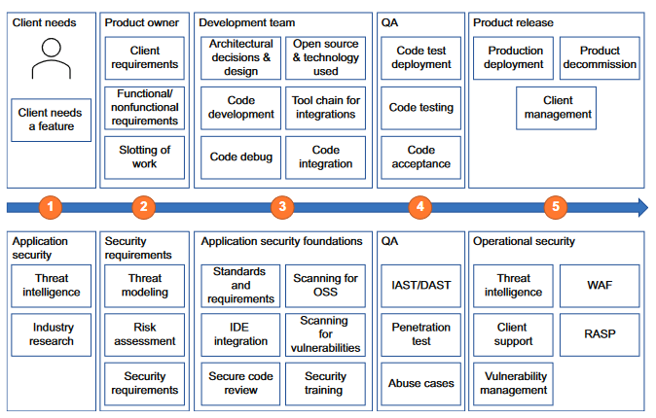
SDLC + AppSec

Slide 40
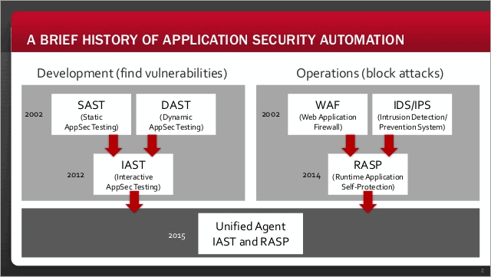
Notes:
RASP is a runtime application that is integrated into an application to analyze inward and outward traffic and end-user behavioral pattern to prevent security attacks.

Slide 41
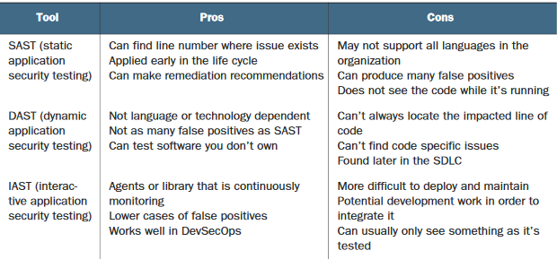

Slide 42
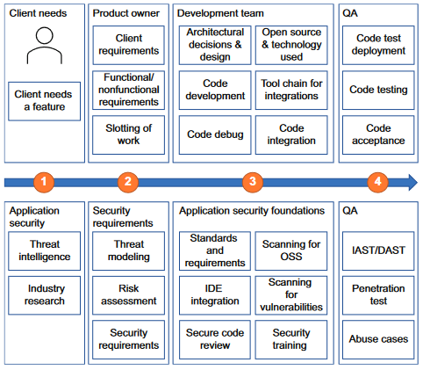
Shift Left Approach
Notes:
STRIDE (spoofing, tampering, repudiation, information disclosure, denial of service,
and elevation of privilege

Slide 43
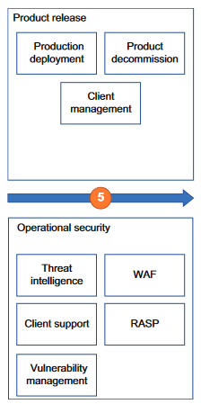
Shift Right Approach
“Attackers only need to be in the right place at the right time, once. Defenders need to be right every time”

Slide 44
Case:
In 2018, a vulnerability in Facebook led to the compromise of tens of millions of Facebook accounts. The flaw was in a feature that allowed a user to view their profile from the point of view of a different account. No surprise, this feature was called “View As.” Bad actors were able to steal the access tokens of Facebook accounts that allowed them to then log in as the user that the access tokens were associated with. They started with their own connected friends and from there stole the access tokens from their friends’ connections until they had collected several hundred thousand accounts and then several million. They were able to collect personal data, including the usual suspects of name, contact information, places the user checked in, and other private data.

